Slide 1
Efficient DERT

Slide 2
Paper Details
Paper Title: Efficient DETR: Improving End-to-End Object Detector with Dense Prior
Publication Date: 3 Apr 2021
Publisher: Zhuyu Yao, Jiangbo Ai, Boxun Li, Chi Zhang
Affiliation: Megvii Technology

Slide 3
Motivation
both DETR and Deformable DETR have a 6-encoder and 6-decoder transformer architecture
investigate the components of DETRs for understanding their mechanism
find out random initialization can be improved
Improve DERT with better initialization
Notes:
We hypothesize that this structure is the key for the DETR series to achieve high accuracy in object detection. We explore that the random initialization of object containers in DETRs is mainly responsible for the requirement of multiple refinement times (i.e., decoder layers) and leads slow convergence

Slide 4
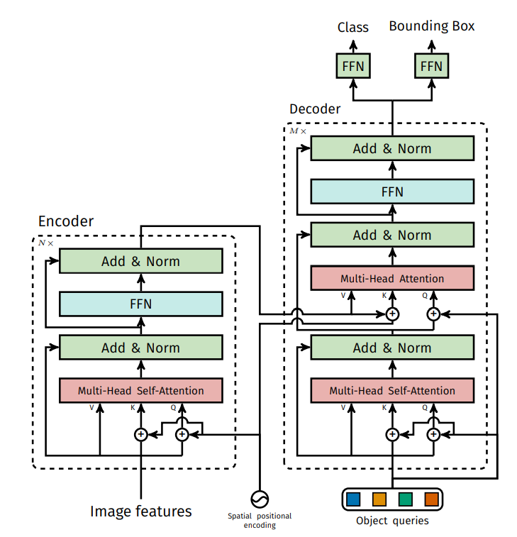
Brief Retrospect of DETR
Notes:
Backbone features are passed through 6 encoder layers to extract context information for each position of the feature maps. Object queries, defined as learned positional encodings [34, 2], are sent to 6 decoder layers to iteratively interact with the encoder features. Final results are predicted from object queries by a detection head. A set prediction loss, i.e., the bipartite matching loss, is added to each decoder layer for refinement. Without any hand-crafted components, DETR directly predicts a set of boxes with scores as the final predictions. To solve the long training process needed by DERT, Deformable DETR and Sparse RCNN both propose an effective good solution

Slide 5
Exploring DETR
Encoder and Decoder
Initializaion of object containers

Slide 6
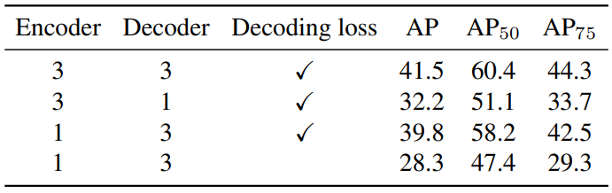
Exploring DETR
Encoder and Decoder
Difference between Encoder and Decoder: Auxiliary loss
Notes:
Encoder vs. Decoder. Experiments are conducted on a Res50 Deformable DETR with 100 proposals and 3× training schedule. Why is the decoder more important than encoder? They find that the auxiliary decoding loss is the main reason why DETR is more sensitive to the number of decoder layers. They think auxiliary loss introduces strong. The cascade structure of the decoder refines features with layer-wise auxiliary loss. The more times of iterations, the more efficient auxiliary decoding supervision.

Slide 7
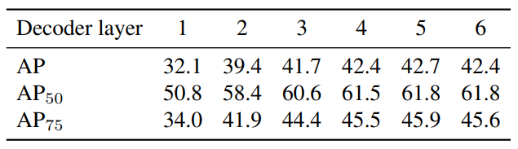
Exploring DETR
Encoder and Decoder
Decoder
Notes:
To further explore the cascade structure of the decoder, we try different numbers of decoder layers. It is worth noting that only object queries are updated after each iteration. Object queries are strongly correlated to performance as final predictions are predicted from them by a detection head. However, object queries are randomly initialized at the start of training. We hypothesize that this random initialization does not offer a good initial state, which might be the reason why DETR needs a cascade structure of 6 iterations to achieve competitive performance.

Slide 8
Exploring DETR
Encoder and Decoder
Decoder
Initialization of object queries
Reference point
2-d tensor
Predictions of box centers
Linear projection
Object query
256-d
Notes:
The object query is defined as the learned positional embedding, which is a 256-d abstract tensor and hard to analyze. They find out each object query learns to specialize in certain areas and box sizes. There is a term form Deformable DETR, called referenced point which is related to object queries. In addition, the reference points are predicted from the 256-d object query via a linear projection. They could serve as the projection of object query in the 2D space and offer an intuitive presentation of the location information in object query

Slide 9
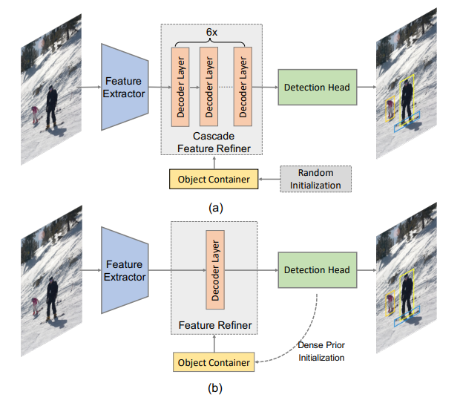
Exploring DETR
Encoder and Decoder
Decoder
Initialization of object queries
Notes:
First, we have to define the object container as a container of structured information, which includes different kinds of object features. Object queries and reference points both belong to the object container, since the object queries and the reference points could represent the abstract features and positional information of objects. A set of randomly initialized object containers are fed to a feature refiner to interact with the features extracted from the image. Specifically, 6 decoder layers with cross-attention modules play the role of a cascade feature refiner which updates object containers iteratively. The refined object containers contribute to the final predictions of DETR.

Slide 10
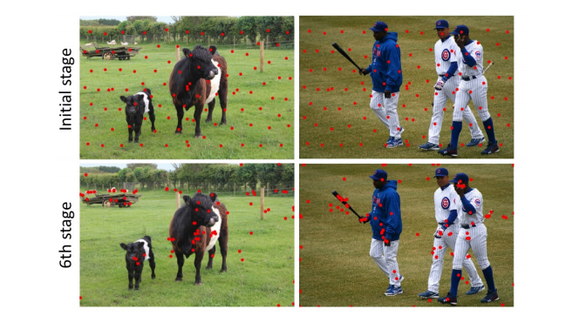
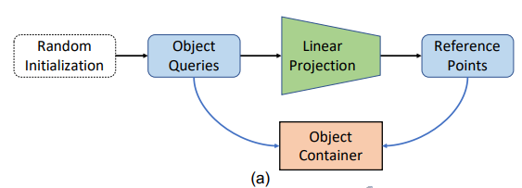
Exploring DETR
Encoder and Decoder
Decoder
Initialization of object queries
Notes:
Considering that reference points intuitively represent the location information in object queries, we start our exploration from them. Before passing to decoder layers, reference points are generated via a linear projection over randomly initialized object queries

Slide 11
Exploring DETR
Encoder and Decoder
Decoder
Initialization of object queries
Notes:
Considering that reference points intuitively represent the location information in object queries, we start our exploration from them. Before passing to decoder layers, reference points are generated via a linear projection over randomly initialized object queries. We point out that this initialization is similar to the generation of anchor points in anchor-based detectors. As the iterative stage increases, reference points gradually gather to the centers of the foreground and finally cover almost all foreground at the last stage. For the remaining part, we call the initialization of reference points and object queries the initialization of object containers.

Slide 12
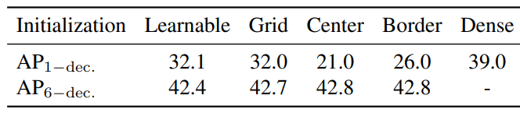
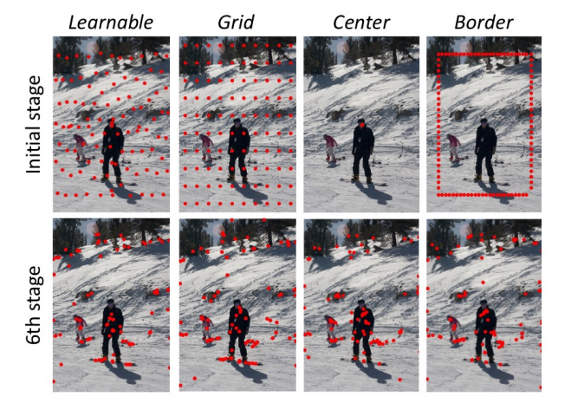
Exploring DETR
Encoder and Decoder
Decoder
Initialization of object queries
Notes:
From the intuition before, they want to figure out the best initialization. In anchor based detectors, the generation of anchors has a great effect on the model’s performance. Mostly, anchors are generated at each sliding-window location, which proves to be a proper initialization for the proposals of objects. different initialization behaves quite differently in non-cascade structures. On the contrary, they lead to a similar performance in a cascade structure. From another perspective, better initialization of reference points may improve the performance in non-cascade structure.

Slide 13
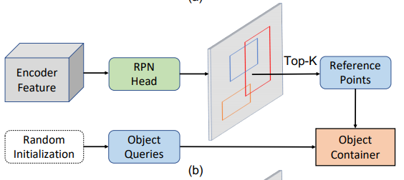
Exploring DETR
Encoder and Decoder
Decoder
Initialization of object queries
Notes:
Can we bring the gap of 1-decoder structure and 6- decoder structure with better initialization? Considering that reference points serve as anchor points, we hypothesize that the anchor prior in mainstream detectors might help us to solve this problem. In modern two-stage detectors, region proposals are generated by RPN in a sliding-window paradigm to offer a set of class agnostic candidates for the foreground. The RPN head shares the features of the encoder and predicts the objectness score and offsets of anchors. Top scored bounding boxes are selected as region proposals. We then initialize reference points with the center of region proposals in a non-cascade structure

Slide 14
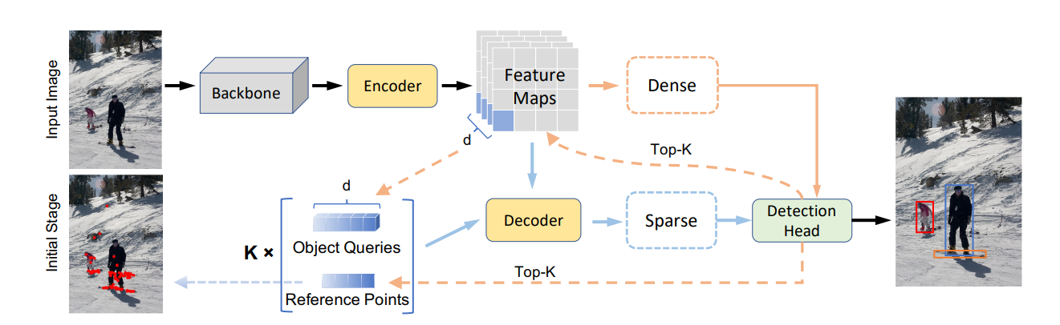
Exploring DETR
Encoder and Decoder
Decoder
Initialization of object queries
Notes:
This illustration demonstrates the visualization of the method, where reference points at the initial stage get a similar distribution as that of other methods at the last stage.

Slide 15
Exploring DETR
Encoder and Decoder
Decoder
Initialization of object queries
Notes:
This illustration demonstrates the visualization of the method, where reference points at the initial stage get a similar distribution as that of other methods at the last stage. For each reference point in proposal initialization, we pick its corresponding features from the feature maps, i.e., a 256-d tensor from the encoder, as the initialization of its object query.

Slide 16
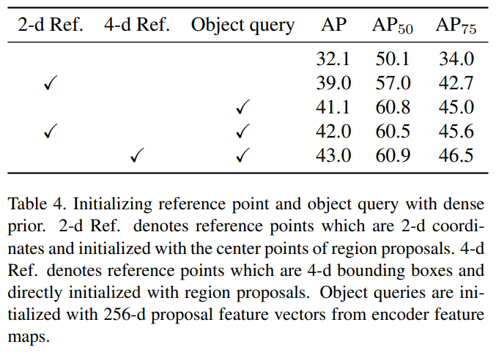
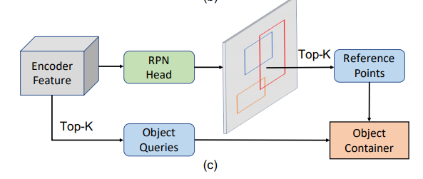
Exploring DETR
Encoder and Decoder
Decoder
Initialization of object queries
Notes:
However, the reference point is just the spatial projection of the object query, while the object query contains extra abstract information of the object container. So, how about initializing the 256-d query feature with dense prior at the same time. Based on our study, we propose Efficient DETR which is able to bring the performance gap between 1-decoder structure and 6-decoder structure.

Slide 17
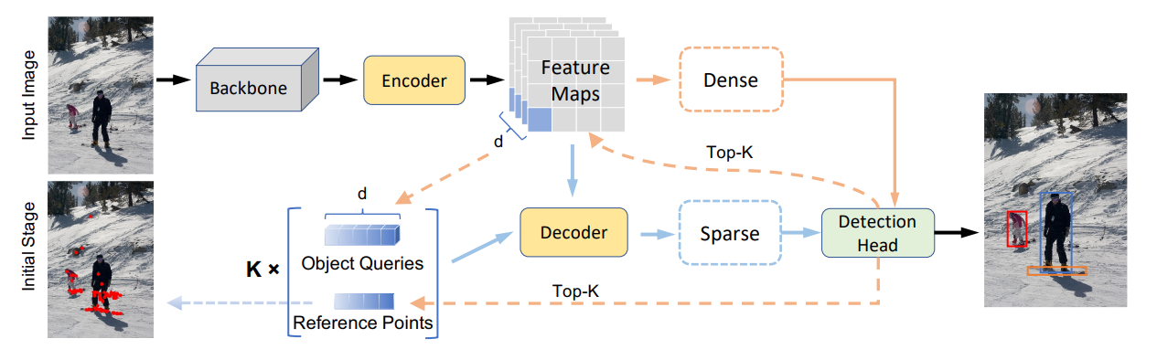
Efficient DETR Archtecture
Notes:
Inspired by the findings in the previous section, we present a simple but efficient framework for object detection, called Efficient DETR. Efficient DETR is formed of two parts: dense and sparse. The dense part does predictions on dense features from the encoder. A top-k selection method is applied to pick a set of proposals from the dense predictions. The 4-d proposals and its 256- d feature from the decoder are taken as the initialization of reference points and object queries. In the sparse part, object containers, the reference points, and object queries initialized with dense prior are fed to a 1-layer decoder to interact with the encoder feature for further refinement. The final results are predicted from the refined object containers. Both parts share the same detection head.

Slide 18
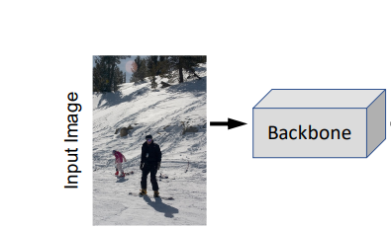
Efficient DETR Archtecture
Backbone
Notes:
Following the design of Deformable DETR, we build a backbone with multi-scale feature maps extracted from ResNet. Our backbone has four scales of feature maps with 256 channels. The first three feature maps are extracted from C3, C4, C5 feature maps of ResNet by a 1×1 stride 1 convolution. While the last feature map is generated via a 3×3 stride 2 convolution on C5. Following the design of Deformable DETR, we build a backbone with multi-scale feature maps extracted from ResNet. Our backbone has four scales of feature maps with 256 channels. The first three feature maps are extracted from C3, C4, C5 feature maps of ResNet by a 1×1 stride 1 convolution. While the last feature map is generated via a 3×3 stride 2 convolution on C5.

Slide 19
Efficient DETR Archtecture
Backbone
Dense part
Notes:
The dense part is formed of the backbone, encoder and a detection head.

Slide 20
Efficient DETR Archtecture
Backbone
Dense part
Sparse part
Notes:
The use of output of dense part: The output of the dense part has a size of encoder feature. We select a set of them by their objectness score, which is defined as the confidence of being a foreground. For each anchor, we take the max category score, predicted by its 256-d encoder feature, as its objectness score. K proposals with the largest scores are picked as reference points. Here, we use reference points as 4-d boxes instead of 2-d centers for more spatial information.
As for object queries, they are taken from encoder feature maps. In the dense part, the prediction for each anchor is from a 256-d feature in encoder feature maps. We take this 256-d feature as the proposal feature. The proposal features and reference points appear in pairs and are connected by the same anchor。
We take the max category score of each anchor as its objectness score, which denotes the confidence of being a foreground.

Slide 21
Efficient DETR Archtecture
Backbone
Dense part
Sparse part
Notes:
In traditional detection methods [12, 9, 27, 24, 20], one-stage detectors face feature misalignment, while the two-stage detectors solve this problem by ROIAlign [10, 23] or ROIPool [27]. In our sparse part, the misalignment is fixed by the decoder, in which the cross-attention modules enable object queries to aggregate features relevant to it. Final predictions are from these enhanced object queries.

Slide 22
Efficient DETR Archtecture
Backbone
Dense part
Sparse part
Proposals
Notes:
Different from previous DETRs, our number of proposals is dynamically tuned during the training process. Given that the network is not able to predict accurate category scores at the beginning of training, a large number of proposals ( 300) is set from the start. This mainly ensures almost all foregrounds are covered in the sparse set of proposals.

Slide 23
Efficient DETR Archtecture
Backbone
Dense part
Sparse part
Proposals
Loss
Notes:
Lcls represents focal loss for classification. LL1 and Lgiou represent L1 loss and generalized IoU loss in for localization. λcls, λL1 and λgiou are coefficients of them.

Slide 24
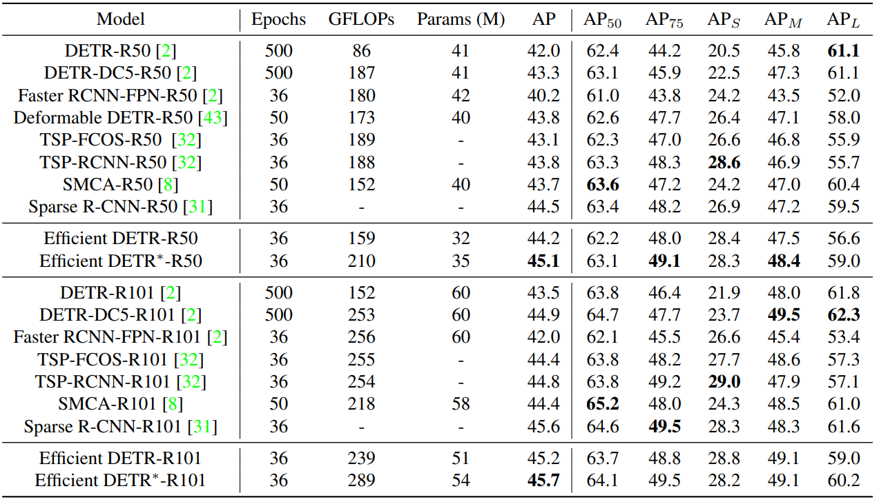
Efficient DETR Results

Slide 25
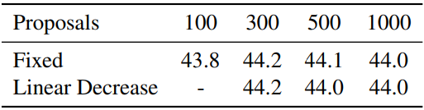
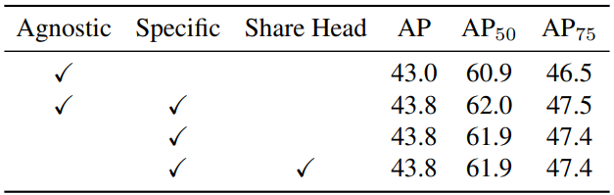
Efficient DETR Results

Slide 26
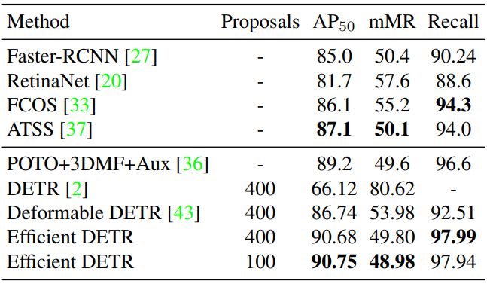
More Experiments
CrowdHuman Data (Crowded Scenes)
Notes:
We evaluate our method on the CrowdHuman dataset [29] to verify the robustness of Efficient DETR in crowded scenes.

